Slide 1
VUE - CHAPTER 6
SLOTS
DYNAMIC
COMPONENTS

Slide 2
WHY
THIS
CLASS ?

Slide 3
BIG CSS RULES FILES
ARE NOT
MAINTAINABLE

Slide 4
Objectives
Scoped VS global styles
Slots : structure components into multiple components
Good project structure

Slide 5

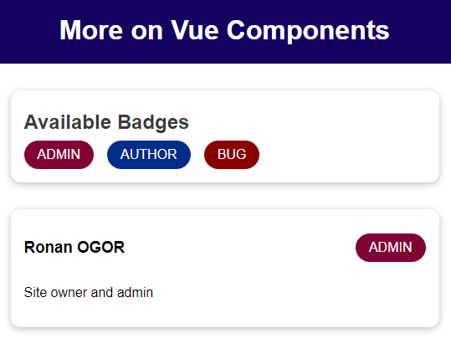
DEMO 1
The dummy app
THE
FIND
COMPONENT
DIAGRAM

Slide 6
DEMO 1
Component diagram
<header>
PROPS
PROPS
<app>
<user-info>
<badge>
fullName
infoText
'role
Type
caption
PROPS
<badge-list>
<badge>
Type
caption

Slide 7

Register component locally !!
components : { you-component-tag : yourComponent }
If they are not used elsewhere in the project

Slide 8

ACTIVITY 1
05MIN
Register locally in App.vue the following components
the-header
badge-list
user-info

Slide 9
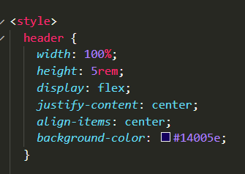
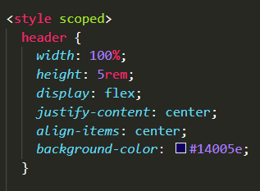
VS
Global style
Local style
The header style will be available
everywhere
The header style will be available
Only on this component

Slide 10
CAN YOU EXPLAIN HOW SLOT WORK?
RESULT
BASE-CARD.VUE
STUDENT-CARD.VUE
<template>
<h1>{{ title }}</h1>
<div>
<slot></slot>
</div>
</template>
<template>
<base-card title=“Student”>
<ul>
<li>Name<li>
<li>Age<li>
</ul>
</base-card>
</template>
<h1>Student</h1>
<ul>
<li>Name<li>
<li>Age<li>
</ul>

Slide 11

BRAINSTORMING
VC

Slide 12
PER TEAM
1 POST-IT
1 POST-IT
WHAT HAVE YOU LEARNED
DURING THIS
FIRST 2 ITERATIONS
WHAT WAS THE MOST DIFFICULT TO MANAGE
WHAT WOULD YOU LIKE IMPROVE FOR THE NEXT ITERATIONS

Slide 13
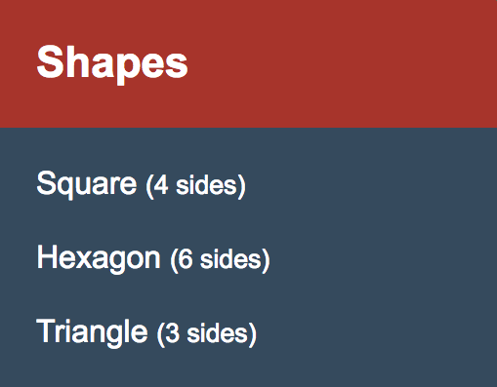
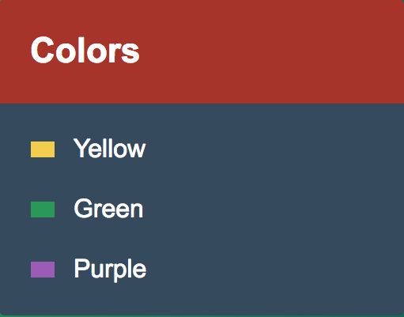
Slot allows to customize the body of a widget:
SLOTS
<card-shape>
<card-base>
Square
Hexagon
Triangle
{{title}}
SLOT
SLOTS
<card-color>
<card-base>
Yellow
Green
Purple

Slide 14
PROPS
SLOTS
VS
FOR DATA
FOR HTML TEMPLATE
A child component needs
A child component needs

Slide 15
DEMO 2
Create a card-base component
Card base is just a ‘wrapper’
around dynamic content

Slide 16
Slot allows to customize the body of a widget:
SLOTS
<card-shape>
<card-base>
Square
Hexagon
Triangle
{{title}}
SLOT
SLOTS
<card-color>
<card-base>
Yellow
Green
Purple

Slide 17
What about multiple slots ?
{{title}}
Slot for body of the card
SLOT
Slot for footer of the card
SLOT

Slide 18
What about multiple slots ?
{{title}}
SLOT
<slot name=“body”>
SLOT
1 – Name your slot
2 – Link the content to the slot using v-slot
V-slot:body
<template #default>

Slide 19
Project structure
/components
/customers
Each feature has its own folder
CustomerView.vue
CustomerCard.vue
CustomerFilter.vue
/UI
ImageSelector.vue
Dialog.vue

Slide 20
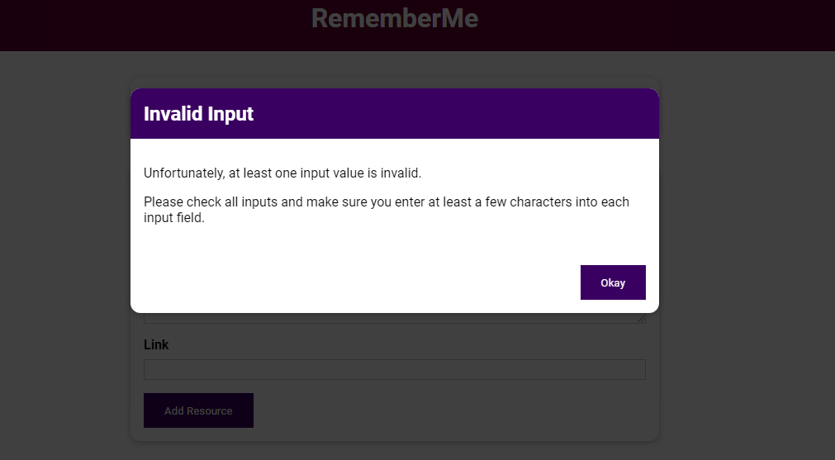
DEMO 3
Create a dialog widget

Slide 21
To sum up
STYLE
Define global styles in your app.vue (font, color definitions…)
Specific styles of components are defined using scoped

